Slide 1
Statistical Analysis
in G-SRS
Samir Lababidi
Lawrence Callahan
FDA Office of the Commissioner
Office of the Chief Scientist
Office of Health Informatics
11/16/2018

Slide 2
Comparing Adverse Events in G-SRS
Identify common substances between:
Lactic vs. Other Adverse Events Acidosis (Aplastic Anemia, Hemolytic Anemia, Colitis Ischaemic, etc.)
Use PRR as a metric of association

Slide 3
What is PRR?
PRR = Proportional Reporting Ratio
is The degree of disproportionate reporting of an AE for a product of
interest compared to this same event for all other products
 | Event Y | All other events
Product X | a | b | a + b
All other products | c | d | c + d
 | a + c | b + d | Total
PRR = [a/(a+b)] / [c/(c+d)]
If PRR >> 1 then Event Y is “disproportionately
reported for Product X
Issues with PRR:
It does not adjust for small counts
Every report represents a suspicion of an AE related to a product

Slide 4
Comparing Adverse Events in G-SRS
Typically there are too many small values, so that the distribution of PRR would be highly skewed to the left.
Transform the PRR values using Log_{e}:
  Normalization
  Valid statistical inference
  Better graphics

Slide 5
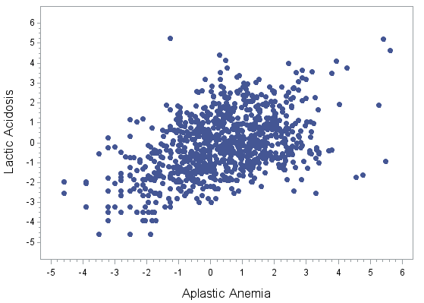
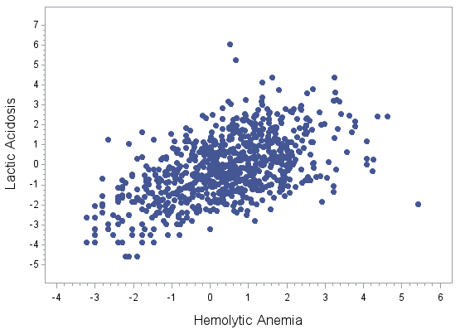
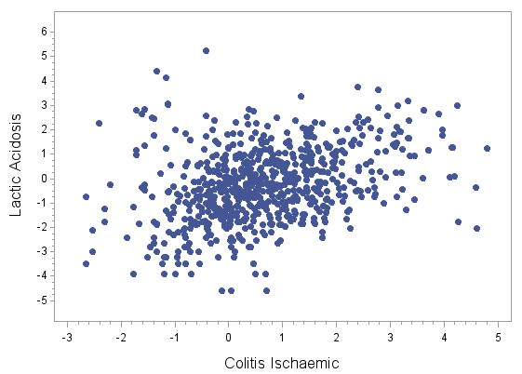
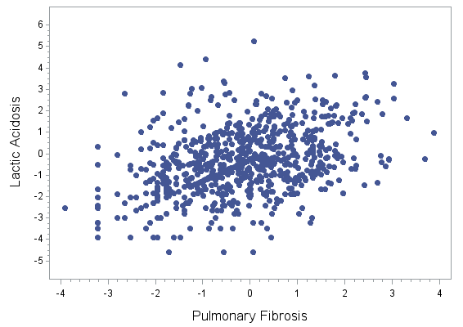

Slide 6
Pairwise analysis Lactic Acidosis (N=1203) vs. DME’s
 | DME Adverse Event | No. Substances | No. Common Substances with Acidosis | %Common | Correlation Coefficient
1 | Liver necrosis | 1534 | 933 | 61 | 0.6522
2 | Acute pancreatitis | 1915 | 1095 | 57 | 0.6262
3 | Rhabdomyolysis | 1660 | 984 | 59 | 0.6035
4 | Liver failure | 1840 | 1058 | 58 | 0.5967
5 | Toxic epidemal necrolysis | 1923 | 984 | 51 | 0.5667
6 | Renal failure | 2517 | 1170 | 46 | 0.5629
7 | Hemolytic anemia | 1312 | 874 | 67 | 0.5562
8 | Stevens Johnson syndrome | 2037 | 1016 | 50 | 0.5537
9 | Haemolysis | 1095 | 792 | 72 | 0.5204
10 | Disseminated intravascular coagulation | 1505 | 951 | 63 | 0.5156
11 | Ventricular fibrillation | 1343 | 884 | 66 | 0.5061
12 | Tosade de Pointes | 883 | 648 | 73 | 0.5059
13 | Acute respiratory failure | 2257 | 1131 | 50 | 0.4985
14 | Pancytopenia | 1752 | 993 | 57 | 0.4747
15 | Product infectious disease transmission | 399 | 268 | 67 | 0.4739
16 | Sudden death | 1379 | 903 | 65 | 0.4698
17 | Aplastic anemia | 1526 | 933 | 61 | 0.4522
18 | Agranulocytosis | 2109 | 1079 | 51 | 0.4466
19 | Liver transplant | 587 | 466 | 79 | 0.4107
20 | Anaphylaxis and anaphylactoid reactions | 2372 | 1066 | 45 | 0.4031
21 | PML Progressive multifocal leukoencephalopathy | 319 | 264 | 83 | 0.3986
22 | TTP | 681 | 545 | 80 | 0.3924
23 | Pulmonary hypertension | 1223 | 858 | 70 | 0.3824
24 | Seizure | 1301 | 869 | 67 | 0.3802
25 | Congenital anomalies | 947 | 606 | 64 | 0.3756
26 | Pulmonary fibrosis | 1078 | 769 | 71 | 0.3684
27 | Colitis ischaemic | 964 | 720 | 75 | 0.3542
28 | Deaf | 1546 | 938 | 61 | 0.3381
29 | Suicide | 1377 | 826 | 60 | 0.3303
30 | Serotonin syndrome | 758 | 556 | 73 | 0.3281
31 | Blind | 1618 | 953 | 59 | 0.2822
32 | ALS Amyotrophic lateral sclerosis | 376 | 334 | 89 | 0.2433
33 | Neuroleptic malignant syndrome | 691 | 475 | 69 | 0.1959
34 | Endotoxic shock confirmed or suspected | 1524 | 978 | 64 | 0.0033

Slide 7
Pairwise analysis Lactic Acidosis (N=1203) vs. DME’s
 | DME Adverse Event | No. Substances | No. Common Substances with Acidosis | %Common | Correlation Coefficient
1 | Liver necrosis | 1534 | 933 | 61 | 0.6522
2 | Acute pancreatitis | 1915 | 1095 | 57 | 0.6262
3 | Rhabdomyolysis | 1660 | 984 | 59 | 0.6035
4 | Liver failure | 1840 | 1058 | 58 | 0.5967
5 | Toxic epidemal necrolysis | 1923 | 984 | 51 | 0.5667
6 | Renal failure | 2517 | 1170 | 46 | 0.5629
7 | Hemolytic anemia | 1312 | 874 | 67 | 0.5562
8 | Stevens Johnson syndrome | 2037 | 1016 | 50 | 0.5537
9 | Haemolysis | 1095 | 792 | 72 | 0.5204
10 | Disseminated intravascular coagulation | 1505 | 951 | 63 | 0.5156
11 | Ventricular fibrillation | 1343 | 884 | 66 | 0.5061
12 | Tosade de Pointes | 883 | 648 | 73 | 0.5059
13 | Acute respiratory failure | 2257 | 1131 | 50 | 0.4985
14 | Pancytopenia | 1752 | 993 | 57 | 0.4747
15 | Product infectious disease transmission | 399 | 268 | 67 | 0.4739
16 | Sudden death | 1379 | 903 | 65 | 0.4698
17 | Aplastic anemia | 1526 | 933 | 61 | 0.4522
18 | Agranulocytosis | 2109 | 1079 | 51 | 0.4466
19 | Liver transplant | 587 | 466 | 79 | 0.4107
20 | Anaphylaxis and anaphylactoid reactions | 2372 | 1066 | 45 | 0.4031
21 | PML Progressive multifocal leukoencephalopathy | 319 | 264 | 83 | 0.3986
22 | TTP | 681 | 545 | 80 | 0.3924
23 | Pulmonary hypertension | 1223 | 858 | 70 | 0.3824
24 | Seizure | 1301 | 869 | 67 | 0.3802
25 | Congenital anomalies | 947 | 606 | 64 | 0.3756
26 | Pulmonary fibrosis | 1078 | 769 | 71 | 0.3684
27 | Colitis ischaemic | 964 | 720 | 75 | 0.3542
28 | Deaf | 1546 | 938 | 61 | 0.3381
29 | Suicide | 1377 | 826 | 60 | 0.3303
30 | Serotonin syndrome | 758 | 556 | 73 | 0.3281
31 | Blind | 1618 | 953 | 59 | 0.2822
32 | ALS Amyotrophic lateral sclerosis | 376 | 334 | 89 | 0.2433
33 | Neuroleptic malignant syndrome | 691 | 475 | 69 | 0.1959
34 | Endotoxic shock confirmed or suspected | 1524 | 978 | 64 | 0.0033

Slide 8
Lactic Acidosis vs. Hemolytic Anemia

Slide 9
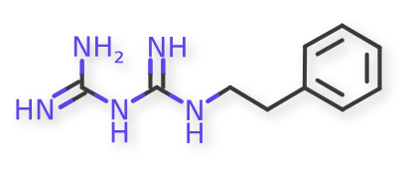
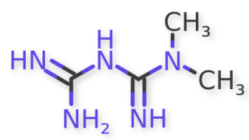
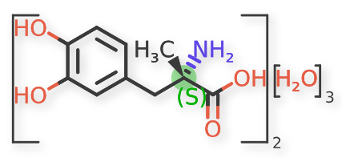
Lactic Acidosis vs. Hemolytic Anemia
Outliers
PHENFORMIN
METFORMIN
METHYLDOPA

Slide 10
Comparing All DME’s

Slide 11
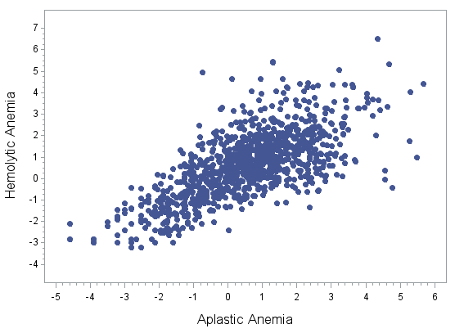
Summary Statistics
Counts = 1043
Correlation Coefficient = 0.698

Slide 12
Pairwise Analysis of All DME’s
We have 34 DME’s in the system currently
There are: 33*34/2=561
pairwise comparisons
Sort by Pearson’s correlation coefficient in descending order

Slide 13
Pairwise Analysis of All DME’s (Top 30)
 | DME1 | DME2 | No. of Common Substances | Correlation Coefficient
1 | Stevens Johnson syndrome | Toxic epidemal necrolysis | 1588 | 0.8857
2 | Agranulocytosis | Pancytopenia | 1499 | 0.8543
3 | Aplastic anemia | Pancytopenia | 1283 | 0.8281
4 | Agranulocytosis | Aplastic anemia | 1361 | 0.7995
5 | Tosade de Pointes | Ventricular fibrillation | 746 | 0.7951
6 | Liver failure | Liver necrosis | 1293 | 0.7722
7 | Liver necrosis | Liver transplant | 541 | 0.7601
8 | Acute respiratory failure | Disseminated intravascular coagulation | 1351 | 0.7545
9 | Liver failure | Liver transplant | 563 | 0.7534
10 | Disseminated intravascular coagulation | Liver necrosis | 1093 | 0.7433
11 | Liver necrosis | Stevens Johnson syndrome | 1249 | 0.7334
12 | Disseminated intravascular coagulation | Pancytopenia | 1191 | 0.7305
13 | Haemolysis | Hemolytic anemia | 892 | 0.7295
14 | Liver necrosis | Toxic epidemal necrolysis | 1219 | 0.7235
15 | Neuroleptic malignant syndrome | Serotonin syndrome | 457 | 0.7174
16 | Liver necrosis | Rhabdomyolysis | 1185 | 0.7148
17 | Aplastic anemia | Disseminated intravascular coagulation | 1119 | 0.7134
18 | Disseminated intravascular coagulation | Liver failure | 1256 | 0.7082
19 | Pancytopenia | Renal failure | 1597 | 0.7054
20 | Aplastic anemia | Hemolytic anemia | 1042 | 0.6979
21 | Endotoxic shock confirmed or suspected | Product infectious disease transmission | 66 | 0.6899
22 | Haemolysis | TTP | 566 | 0.6827
23 | Acute respiratory failure | Renal failure | 1922 | 0.6787
24 | Disseminated intravascular coagulation | TTP | 617 | 0.6787
25 | Acute respiratory failure | Liver failure | 1572 | 0.6754
26 | Hemolytic anemia | TTP | 606 | 0.6701
27 | Disseminated intravascular coagulation | Toxic epidemal necrolysis | 1177 | 0.6684
28 | Agranulocytosis | Disseminated intravascular coagulation | 1258 | 0.6682
29 | Liver failure | Pancytopenia | 1380 | 0.6671
30 | Disseminated intravascular coagulation | Haemolysis | 880 | 0.6651

Slide 14
Pairwise Analysis of All DME’s (Bottom 30)
 | DME1 | DME2 | No. of Common Substances | Correlation Coefficient
531 | Blind | Suicide | 985 | 0.1467
532 | Acute respiratory failure | ALS Amyotrophic lateral sclerosis | 370 | 0.1440
533 | Pancytopenia | Product infectious disease transmission | 300 | 0.1426
534 | ALS Amyotrophic lateral sclerosis | Pulmonary hypertension | 352 | 0.1416
535 | ALS Amyotrophic lateral sclerosis | Seizure | 348 | 0.1388
536 | Haemolysis | Suicide | 717 | 0.1369
537 | Agranulocytosis | Suicide | 1062 | 0.1360
538 | Congenital anomalies | Renal failure | 853 | 0.1349
539 | Agranulocytosis | Product infectious disease transmission | 315 | 0.1345
540 | Anaphylaxis and anaphylactoid reactions | PML Progressive multifocal leukoencephalopathy | 299 | 0.1345
541 | ALS Amyotrophic lateral sclerosis | Blind | 363 | 0.1267
542 | Neuroleptic malignant syndrome | TTP | 316 | 0.1235
543 | Congenital anomalies | Pulmonary fibrosis | 586 | 0.1233
544 | PML Progressive multifocal leukoencephalopathy | Rhabdomyolysis | 284 | 0.1205
545 | Product infectious disease transmission | Renal failure | 354 | 0.1075
546 | Neuroleptic malignant syndrome | Pulmonary fibrosis | 431 | 0.1049
547 | Serotonin syndrome | TTP | 352 | 0.1015
548 | Colitis ischaemic | Suicide | 714 | 0.1002
549 | Aplastic anemia | Suicide | 921 | 0.0706
550 | Liver transplant | Suicide | 475 | 0.0696
551 | Pulmonary hypertension | Suicide | 865 | 0.0555
552 | Pulmonary fibrosis | Serotonin syndrome | 501 | 0.0427
553 | Pancytopenia | Suicide | 984 | 0.0389
554 | ALS Amyotrophic lateral sclerosis | Endotoxic shock confirmed or suspected | 353 | 0.0380
555 | PML Progressive multifocal leukoencephalopathy | Product infectious disease transmission | 92 | -0.0062
556 | PML Progressive multifocal leukoencephalopathy | Serotonin syndrome | 149 | -0.0232
557 | Pulmonary fibrosis | Suicide | 777 | -0.0311
558 | Suicide | TTP | 513 | -0.0335
559 | Neuroleptic malignant syndrome | PML Progressive multifocal leukoencephalopathy | 131 | -0.0552
560 | Endotoxic shock confirmed or suspected | Suicide | 107 | -0.0705
561 | PML Progressive multifocal leukoencephalopathy | Suicide | 248 | -0.1272

Slide 15
Effect
of
Different Classes
of Substances

Slide 16
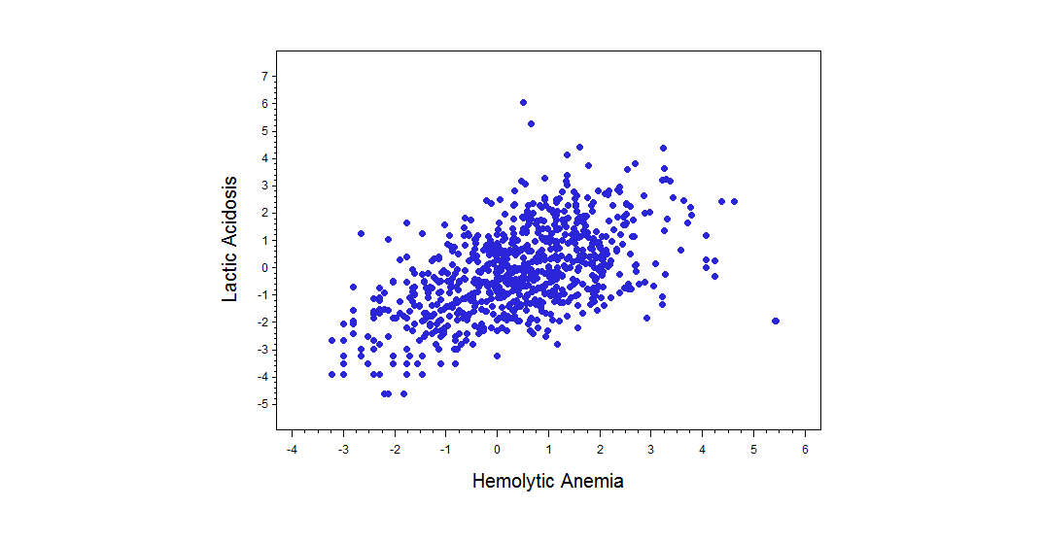
Lactic Acidosis vs. Hemolytic Anemia
All Substances
Summary Statistics
Counts = 874
Cor = 0.556

Slide 17
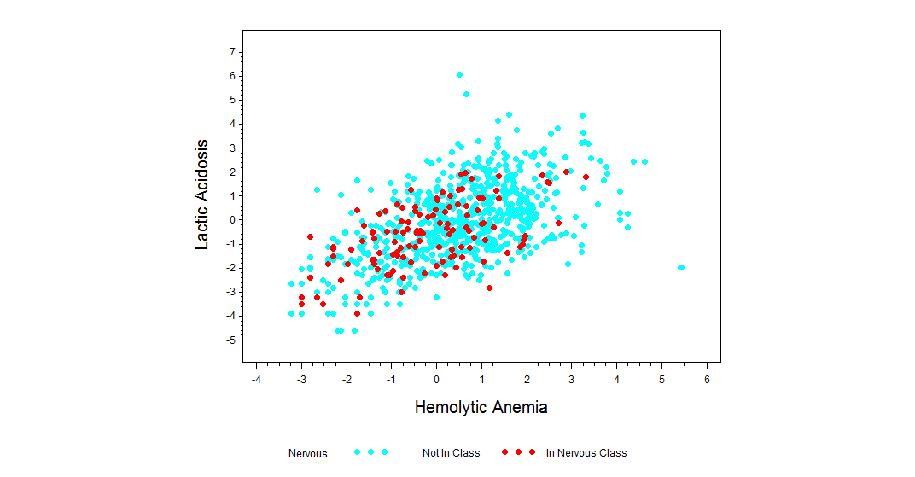
Lactic Acidosis vs. Hemolytic Anemia
Nervous Class
All Substances
Counts = 874
Correlation = 0.556
Nervous Class
Counts = 120
Correlation = 0.560

Slide 18
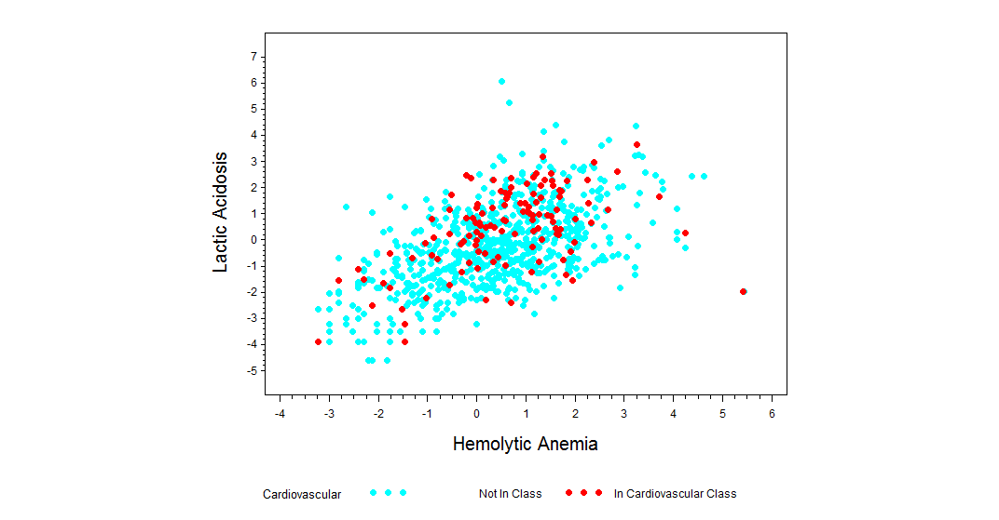
Lactic Acidosis vs. Hemolytic Anemia
Cardiovascular Class
All Substances
Counts = 874
Correlation = 0.556
Cardiovascular Class
Counts = 122
Correlation = 0.494

Slide 19
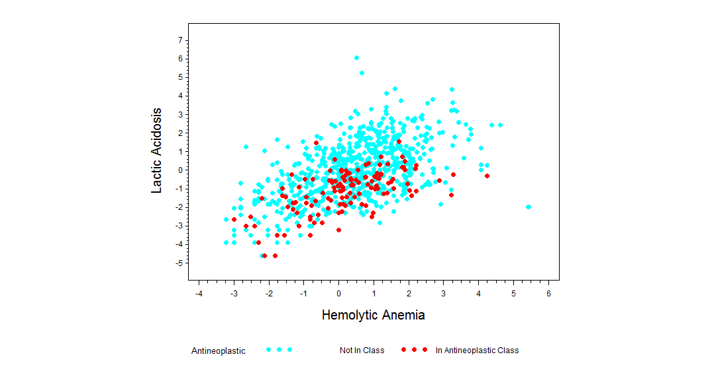
Lactic Acidosis vs. Hemolytic Anemia
Antineoplastic Class
All Substances
Counts = 874
Correlation = 0.556
Antineoplastic Class
Counts = 133
Correlation = 0.594

Slide 20
Diabetes Drugs

Slide 21
Diabetes Drugs
There are 55 substances in G-SRS which are related to diabetes and their relationships to DME Reactions
We investigated the common DME reactions associated with Metformin versus the other 54 substances to see whether there is any particular pattern that is specific to Metformin but not the others.

Slide 22
METFORMIN Vs. All 54 Substances
 | DRUGS | # Common DME Reactions | Correlation Coefficient
1 | GLIMEPIRIDE | 27 | 0.7547
2 | PIOGLITAZONE | 29 | 0.7374
3 | ALBIGLUTIDE | 11 | 0.6651
4 | ACETOHEXAMIDE | 11 | 0.6651
5 | SITAGLIPTIN | 28 | 0.6268
6 | ROSIGLITAZONE | 29 | 0.5422
7 | MIGLITOL | 29 | 0.5422
8 | LIRAGLUTIDE | 24 | 0.5068
9 | EMPAGLIFLOZIN | 23 | 0.4963
10 | GLIPIZIDE | 28 | 0.4933
11 | EXENATIDE | 27 | 0.4631
12 | GLYBURIDE | 28 | 0.4531
13 | PRAMLINTIDE | 12 | 0.4346
14 | TOLRESTAT | 12 | 0.4346
15 | GLIBORNURIDE | 12 | 0.4346
16 | LINAGLIPTIN | 22 | 0.4322
17 | SIMVASTATIN | 31 | 0.4102
18 | CANAGLIFLOZIN | 31 | 0.4102
19 | SAXAGLIPTIN ANHY | 31 | 0.4102
20 | SAXAGLIPTIN MONO | 31 | 0.4102
21 | INSULIN GLARGINE | 29 | 0.3587
22 | INSULIN DEGLUDEC | 16 | 0.3126
23 | INSULIN ASPART | 27 | 0.2766
24 | VOGLIBOSE | 27 | 0.2766
25 | BUFORMIN | 27 | 0.2766
26 | VILDAGLIPTIN | 22 | 0.2678
27 | INSULIN LISPRO | 30 | 0.2350
28 | GLICLAZIDE | 28 | 0.2310
29 | METAHEXAMIDE | 28 | 0.2310
30 | MITIGLINIDE | 28 | 0.2310
31 | GLISOXEPIDE | 28 | 0.2310
32 | GUAR GUM | 28 | 0.2310
33 | GLYMIDINE | 28 | 0.2310
34 | GLIQUIDONE | 28 | 0.2310
 | Drugs | # Common DME Reactions | Correlation Coefficient
35 | CARBUTAMIDE | 28 | 0.2310
36 | GEMIGLIPTIN | 28 | 0.2310
37 | NATEGLINIDE | 23 | 0.2201
38 | TROGLITAZONE | 27 | 0.1897
39 | TOLBUTAMIDE | 27 | 0.1897
40 | DULAGLUTIDE | 20 | 0.1754
41 | INSULIN HUMAN | 28 | 0.1575
42 | REPAGLINIDE | 24 | 0.1482
43 | PHENFORMIN | 24 | 0.1482
44 | INSULIN BEEF | 24 | 0.1482
45 | BENFLUOREX | 24 | 0.1482
46 | DAPAGLIFLOZIN | 25 | 0.1323
47 | INSULIN DETEMIR | 21 | 0.1209
48 | INSULIN GLULISIN | 21 | 0.1209
49 | ALOGLIPTIN | 19 | 0.0966
50 | TOLAZAMIDE | 14 | 0.0754
51 | ACARBOSE | 23 | 0.0161
52 | LIXISENATIDE | 23 | 0.0161
53 | INSULIN PORK | 17 | -0.0329
54 | CHLORPROPAMIDE | 22 | -0.4475

Slide 23
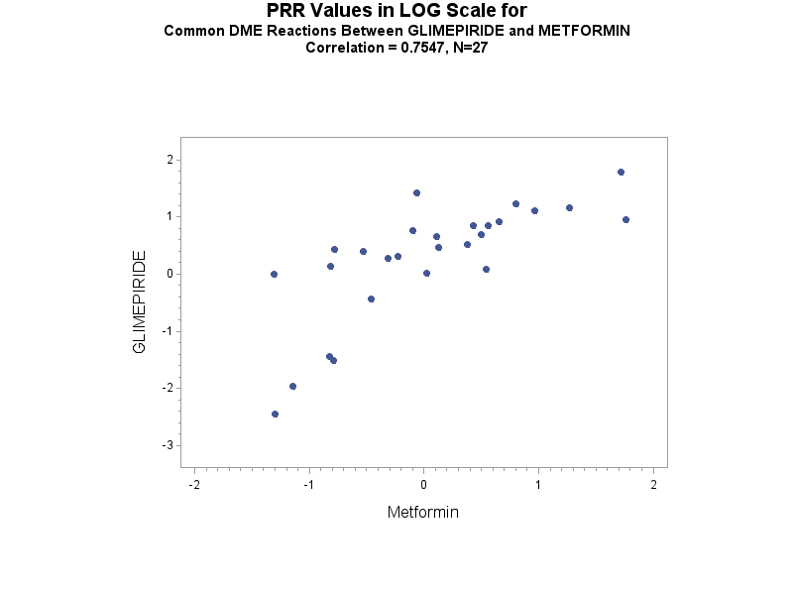
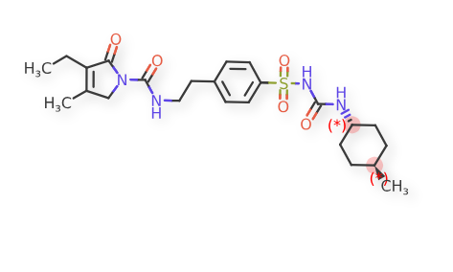
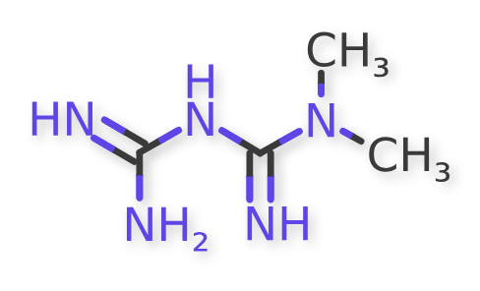
GLIMEPIRIDE
METFORMIN

Slide 24
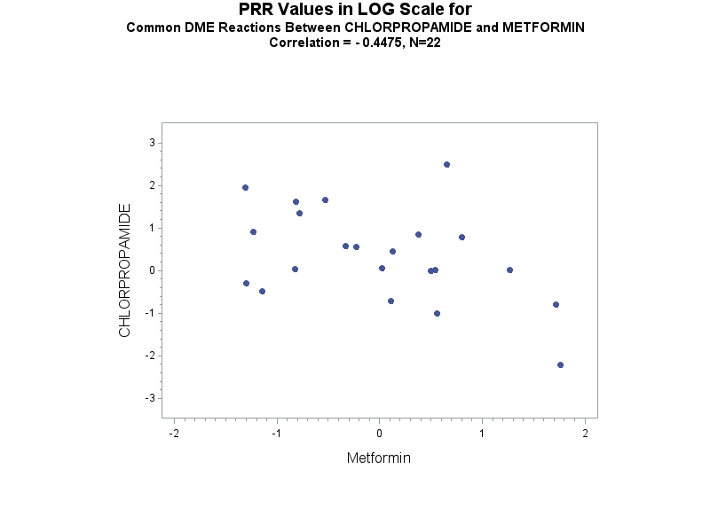
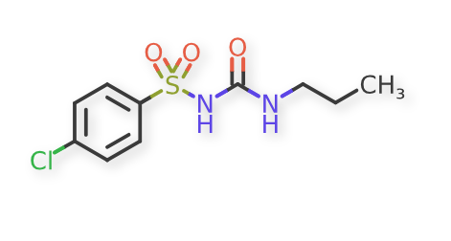
CHLORPROPAMIDE
METFORMIN

Slide 25
Diabetes Drugs
Only 35 substances have CASE_COUNT > 1000, for reliable PRR values.
For these substances we have 33 DME Reactions available in GSRS.

Slide 26
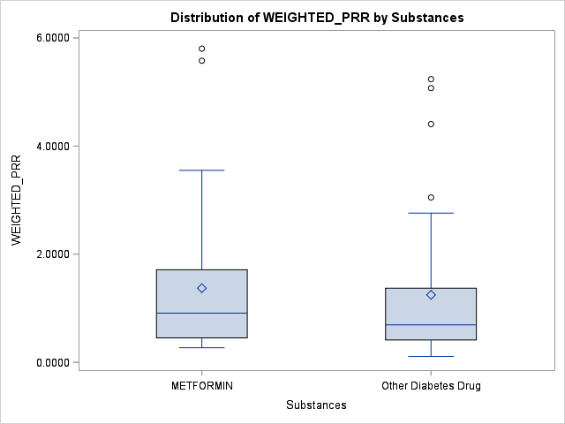
Distribution Difference Between METFORMIN and All Other Substances Combined

Slide 27
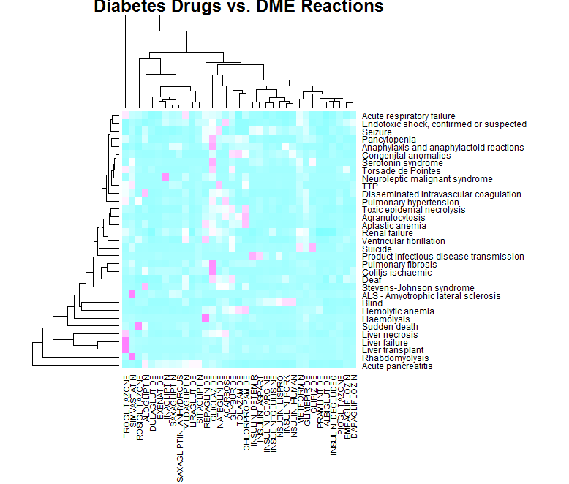
All Substances Associated With Diabetes

Slide 28
All Substances Associated With Diabetes

Slide 29
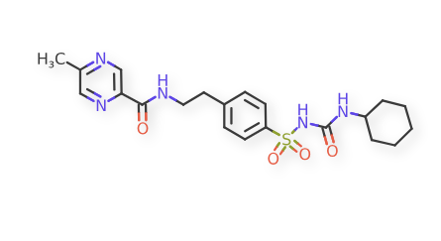
Suicide
Metformin
Glipizide

Slide 30
Analysis at the PT-Term Level

Slide 31
Sulfonylurea Drugs
We are interested in diabetes drugs that have the same target to determine whether they are associated with the same AEs.
Sulfonylurea drugs are special types of antidiabetic drugs that have the same target.
They act by increasing insulin release from the beta cells in the pancreas.

Slide 32
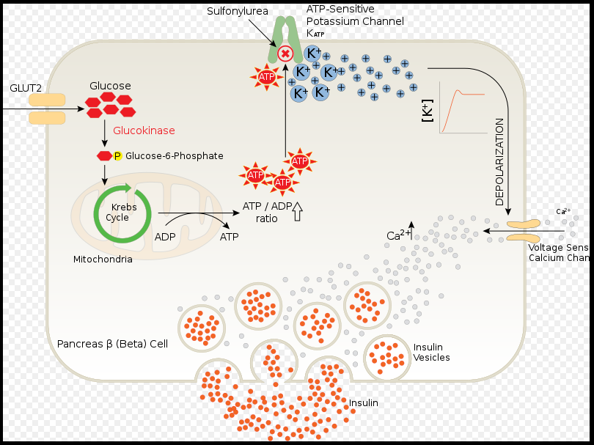
Sulfonylurea Drugs

Slide 33
Sulfonylurea Drugs
There are 5 sulfonylurea drugs found in GSRS which have CASE_COUNT ≥ 1000 and corresponding AEs with PT_TERM ≥ 5:
  CHLORPROPAMIDE
  GLICLAZIDE
  GLIPIZIDE
  GLYBURIDE
  TOLAZAMIDE

Slide 34
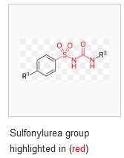
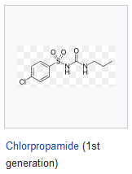
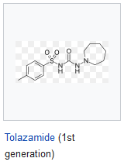
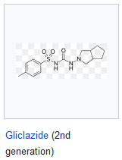
Sulfonylurea Drugs

Slide 35
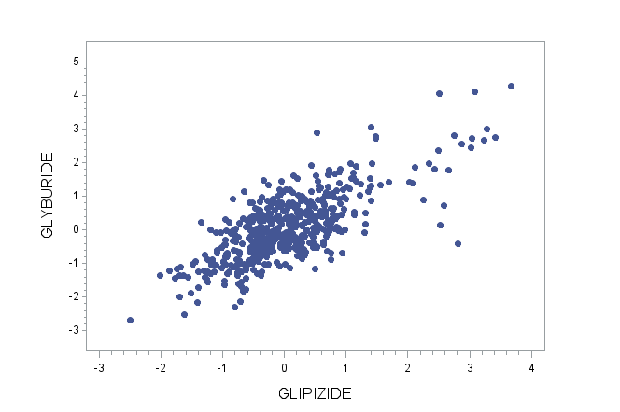
GLYBURIE vs. GLIPIZIDE

Slide 36
GLYBURIE vs. GLIPIZIDE
Outliers
Drug Tolerance
Increased
Medication
Residue Present

Slide 37
GLYBURIE vs. GLIPIZIDE
Common AEs
Hypoglycaemic Coma
Hypoglycaemia

Slide 38
PT-Terms of the Top 5% PRR -- Sulfonylurea Drugs
 | GLICLAZIDE (N=2827) | PT COUNT
1 | HYPOGLYCAEMIA | 548
2 | LACTIC ACIDOSIS | 152
3 | METABOLIC ACIDOSIS | 119
4 | DIABETES MELLITUS INADEQUATE CONTROL | 117
5 | HYPERKALAEMIA | 95
6 | HYPOGLYCAEMIC COMA | 63
7 | PANCREATIC CARCINOMA | 41
8 | PEMPHIGOID | 38
9 | HYPERLACTACIDAEMIA | 33
10 | ACIDOSIS | 31
11 | DIABETIC METABOLIC DECOMPENSATION | 31
12 | BRADYPHRENIA | 23
13 | HEPATITIS CHOLESTATIC | 16
14 | GASTROINTESTINAL MOTILITY DISORDER | 15
15 | VOMITING PROJECTILE | 15
16 | CARDIOACTIVE DRUG LEVEL INCREASED | 14
17 | DISTRIBUTIVE SHOCK | 14
18 | HAEMOGLOBIN INCREASED | 14
19 | HAND DEFORMITY | 14
20 | JOINT NOISE | 14
21 | SCOLIOSIS | 14
22 | BRONCHIECTASIS | 13
23 | POISONING DELIBERATE | 13
24 | PULSE ABNORMAL | 13
25 | HEPATITIS FULMINANT | 12
26 | LICHEN PLANUS | 12
27 | NORMOCHROMIC NORMOCYTIC ANAEMIA | 12
28 | IDIOPATHIC PULMONARY FIBROSIS | 11
29 | URINARY TRACT DISCOMFORT | 10
30 | BRADYKINESIA | 8
31 | DIABETIC HYPEROSMOLAR COMA | 8
32 | SLEEP TERROR | 8
33 | FOETAL DISORDER | 7
34 | JEALOUS DELUSION | 7
35 | RIGHT VENTRICULAR DYSFUNCTION | 7
36 | ACUTE LUNG INJURY | 6
37 | IMPULSE-CONTROL DISORDER | 6
38 | INHIBITORY DRUG INTERACTION | 6
39 | ANAEMIA VITAMIN B12 DEFICIENCY | 5
40 | BODY MASS INDEX DECREASED | 5
41 | CALCIPHYLAXIS | 5
42 | DIABETIC KETOSIS | 5
43 | DIABETIC ULCER | 5
44 | HALO VISION | 5
45 | HYPOGLYCAEMIA NEONATAL | 5
46 | ORBITAL OEDEMA | 5
47 | SLOW RESPONSE TO STIMULI | 5
 | GLYBURIDE (N=11205) | PT COUNT
1 | HYPOGLYCAEMIA | 2671
2 | LACTIC ACIDOSIS | 244
3 | DIABETES MELLITUS INADEQUATE CONTROL | 168
4 | HYPOGLYCAEMIC COMA | 114
5 | DRUG TOLERANCE INCREASED | 70
6 | HYPOGLYCAEMIC UNCONSCIOUSNESS | 29
7 | SHOCK HYPOGLYCAEMIC | 25
8 | HYPOGLYCAEMIC ENCEPHALOPATHY | 18
9 | MUCOSAL EROSION | 17
10 | CONGENITAL MUSCULOSKELETAL ANOMALY | 13
11 | OTITIS EXTERNA | 13
12 | QUADRIPARESIS | 13
13 | MACROSOMIA | 12
14 | METABOLIC ALKALOSIS | 12
15 | SCROTAL OEDEMA | 12
16 | NEPHROCALCINOSIS | 11
17 | GRANULOMATOUS LIVER DISEASE | 9
18 | PULMONARY HYPOPLASIA | 9
19 | DRUG CLEARANCE DECREASED | 8
20 | SPINE MALFORMATION | 8
21 | MICROALBUMINURIA | 7
22 | BLOOD GLUCOSE | 6
23 | BLOOD ZINC DECREASED | 6
24 | TYMPANIC MEMBRANE DISORDER | 6
25 | HYPERINSULINAEMIA | 5
26 | INSULIN C-PEPTIDE INCREASED | 5
27 | PLATELET COUNT NORMAL | 5
28 | RIB HYPOPLASIA | 5
29 | TRANSVERSE PRESENTATION | 5
 | GLIPIZIDE (N=9980) | PT COUNT
1 | HYPOGLYCAEMIA | 1358
2 | HYPERGLYCAEMIA | 705
3 | BLOOD GLUCOSE DECREASED | 452
4 | DIABETES MELLITUS INADEQUATE CONTROL | 287
5 | GLYCOSYLATED HAEMOGLOBIN INCREASED | 195
6 | BLOOD GLUCOSE FLUCTUATION | 144
7 | MEDICATION RESIDUE PRESENT | 110
8 | HYPOGLYCAEMIC COMA | 38
9 | GLUCOSE TOLERANCE DECREASED | 13
10 | ACCIDENTAL POISONING | 8
11 | BLOOD GLUCOSE | 7
12 | MEDICAL DEVICE SITE INFECTION | 6
13 | MICROALBUMINURIA | 6
14 | STOOL ANALYSIS ABNORMAL | 6
 | CHLORPROPAMIDE (N=1904) | PT COUNT
1 | HYPOGLYCAEMIA | 222
2 | INAPPROPRIATE ANTIDIURETIC HORMONE SECRETION | 31
3 | JAUNDICE CHOLESTATIC | 31
4 | CORONARY ARTERY BYPASS | 21
5 | CATARACT OPERATION | 11
6 | LEG AMPUTATION | 10
7 | TOE AMPUTATION | 9
8 | VENOUS OCCLUSION | 9
9 | DIABETIC COMPLICATION | 8
10 | DIABETIC COMA | 7
11 | ANGIOPLASTY | 6
 | TOLAZAMIDE (N=1223) | PT COUNT
1 | HYPERGLYCAEMIA | 137
2 | HYPOGLYCAEMIA | 116
3 | AMBLYOPIA | 70
4 | JAUNDICE CHOLESTATIC | 15
5 | INAPPROPRIATE ANTIDIURETIC HORMONE SECRETION | 14
6 | GANGRENE | 11
7 | KETOACIDOSIS | 11
8 | PATHOLOGICAL FRACTURE | 10
9 | GASTROINTESTINAL CARCINOMA | 8

Slide 39
PT-Terms of the Top 5% PRR -- Sulfonylurea Drugs
Notice that AMBLYOPIA is an AE with PT_COUNT of 70 for TOLAZAMIDE (N=1223)
AMBLYOPIA also known as lazy eye, which is a vision development disorder in which one eye fails to achieve normal visual acuity; the vision of one of the eyes is reduced because the eye and the brain are not working together properly
DAILYMED does not report it as an AE for TOLAZAMIDE

Slide 40
Sulfonylurea Drugs vs.
Other Diabetes Drugs

Slide 41
 | None Sulfonylurea
1 | ACARBOSE
2 | ALBIGLUTIDE
3 | ALOGLIPTIN
4 | DAPAGLIFLOZIN
5 | DULAGLUTIDE
6 | EMPAGLIFLOZIN
7 | EXENATIDE
8 | GLIMEPIRIDE
9 | INSULIN ASPART
10 | INSULIN DEGLUDEC
11 | INSULIN DETEMIR
12 | INSULIN GLARGINE
13 | INSULIN GLULISINE
14 | INSULIN HUMAN
15 | INSULIN LISPRO
16 | INSULIN PORK
17 | LINAGLIPTIN
18 | LIRAGLUTIDE
19 | METFORMIN
20 | NATEGLINIDE
21 | PIOGLITAZONE
22 | PRAMLINTIDE
23 | REPAGLINIDE
24 | ROSIGLITAZONE
25 | SAXAGLIPTIN
26 | SAXAGLIPTIN ANHYDROUS
27 | SIMVASTATIN
28 | SITAGLIPTIN
29 | TROGLITAZONE
30 | VILDAGLIPTIN
 | Sulfonylurea Drugs
1 | CHLORPROPAMIDE
2 | GLICLAZIDE
3 | GLIPIZIDE
4 | GLYBURIDE
5 | TOLAZAMIDE
Vs.

Slide 42
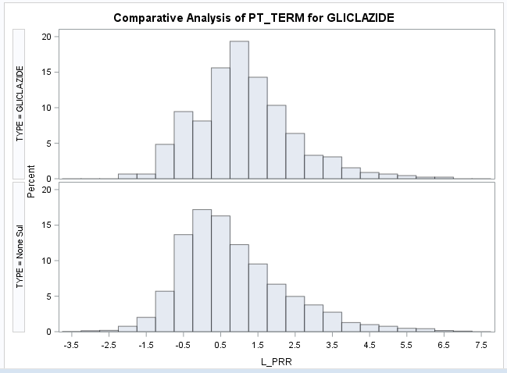
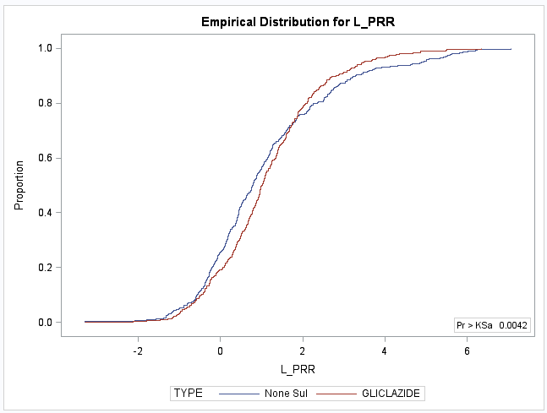
GLICLAZIDE (N=455) versus
30 Non-Sulfonylurea Diabetes Drugs

Slide 43
Sulfonylurea Drugs > Other 30 Diabetes Drugs -- by 50
GLICLAZIDE (N=455)
 | PT_TERM | NONE SUL | GLICLAZIDE
1 | DIABETIC METABOLIC DECOMPENSATION | 36 | 418
2 | DISTRIBUTIVE SHOCK | 24 | 248
3 | DIABETIC KETOSIS | 40 | 238
4 | JEALOUS DELUSION | 6 | 166
5 | HYPOGLYCAEMIC COMA | 26 | 130
6 | BODY MASS INDEX DECREASED | 7 | 108
7 | HYPERLACTACIDAEMIA | 35 | 129
8 | DIABETIC HYPEROSMOLAR COMA | 5 | 84
9 | RIGHT VENTRICULAR DYSFUNCTION | 3 | 77
10 | ACUTE LUNG INJURY | 3 | 62
11 | ORBITAL OEDEMA | 4 | 61
12 | ANAEMIA VITAMIN B12 DEFICIENCY | 16 | 71
13 | CARDIOACTIVE DRUG LEVEL INCREASED | 1 | 53

Slide 44
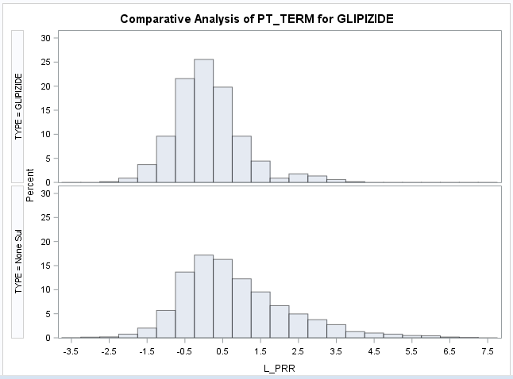
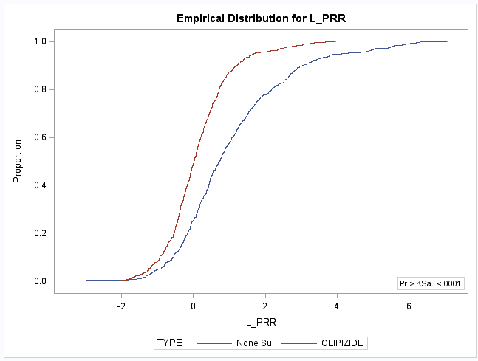
GLIPIZIDE (N=677) versus
30 Non-Sulfonylurea Diabetes Drugs

Slide 45
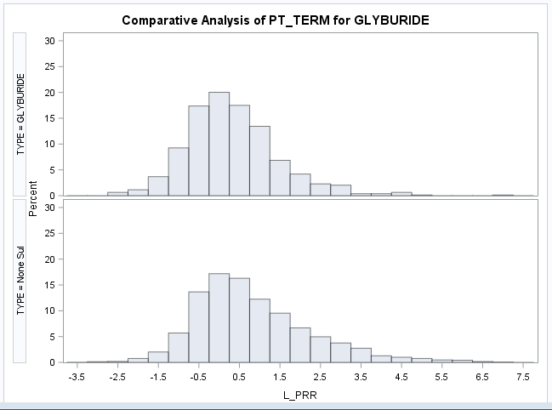
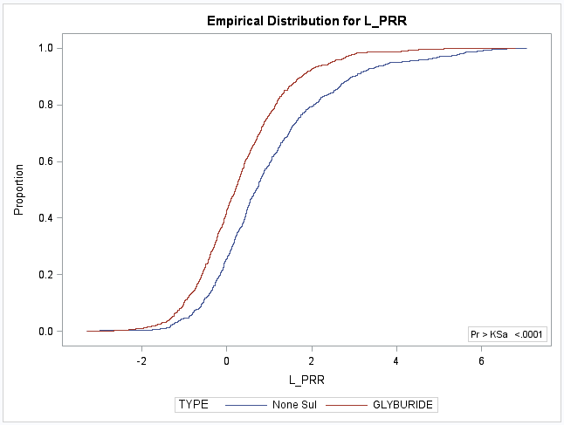
GLYBURIDE (N=789) versus
30 Non-Sulfonylurea Diabetes Drugs

Slide 46
Sulfonylurea Drugs > Other 30 Diabetes Drugs -- by 50
GLICLAZIDE (N=455)
GLYBURIDE (N=789)
 | PT_TERM | NONE SUL | GLICLAZIDE
1 | DIABETIC METABOLIC DECOMPENSATION | 36 | 418
2 | DISTRIBUTIVE SHOCK | 24 | 248
3 | DIABETIC KETOSIS | 40 | 238
4 | JEALOUS DELUSION | 6 | 166
5 | HYPOGLYCAEMIC COMA | 26 | 130
6 | BODY MASS INDEX DECREASED | 7 | 108
7 | HYPERLACTACIDAEMIA | 35 | 129
8 | DIABETIC HYPEROSMOLAR COMA | 5 | 84
9 | RIGHT VENTRICULAR DYSFUNCTION | 3 | 77
10 | ACUTE LUNG INJURY | 3 | 62
11 | ORBITAL OEDEMA | 4 | 61
12 | ANAEMIA VITAMIN B12 DEFICIENCY | 16 | 71
13 | CARDIOACTIVE DRUG LEVEL INCREASED | 1 | 53
 | PT_TERM | NONE SUL | GLYBURIDE
1 | PLATELET COUNT NORMAL | 170 | 892
2 | RIB HYPOPLASIA | 22 | 167
3 | MACROSOMIA | 18 | 91
4 | BLOOD ZINC DECREASED | 15 | 81
5 | HYPOGLYCAEMIC ENCEPHALOPATHY | 38 | 104
6 | HYPOGLYCAEMIA | 12 | 71

Slide 47
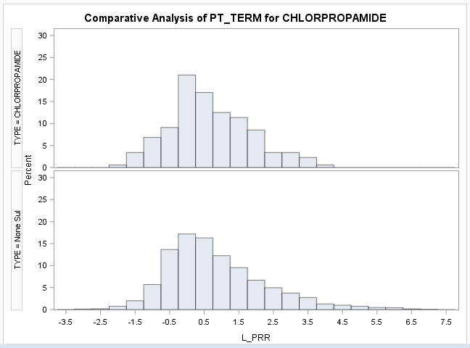
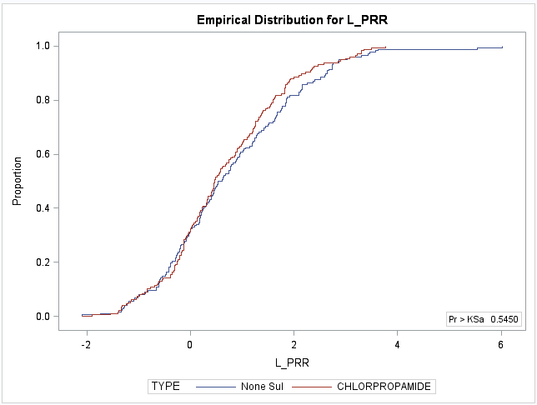
CHLORPROPAMIDE (N=176) versus
30 Non-Sulfonylurea Diabetes Drugs

Slide 48
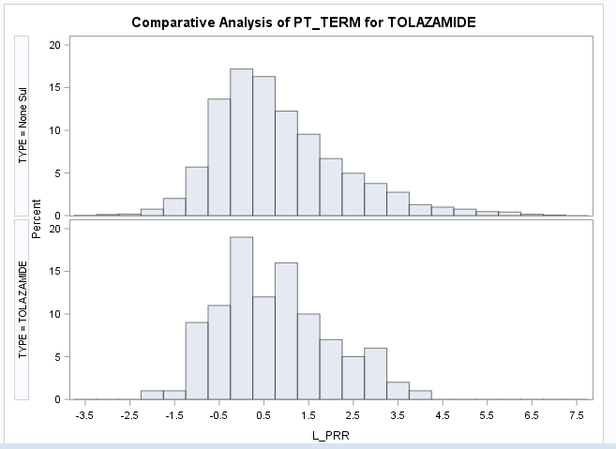
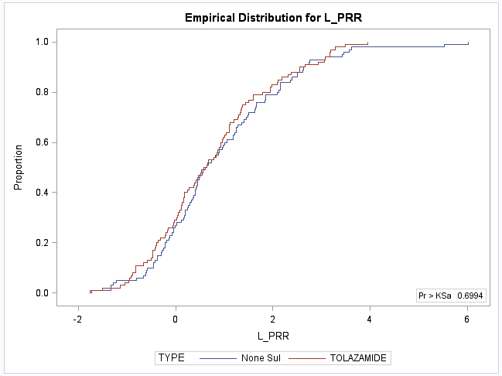
TOLAZAMIDE (N=100) versus
30 Non-Sulfonylurea Diabetes Drugs

Slide 49
Sulfonylurea Drugs > Other 30 Diabetes Drugs -- by 50
GLICLAZIDE (N=455)
GLYBURIDE (N=789)
 | PT_TERM | NONE SUL | GLICLAZIDE
1 | DIABETIC METABOLIC DECOMPENSATION | 36 | 418
2 | DISTRIBUTIVE SHOCK | 24 | 248
3 | DIABETIC KETOSIS | 40 | 238
4 | JEALOUS DELUSION | 6 | 166
5 | HYPOGLYCAEMIC COMA | 26 | 130
6 | BODY MASS INDEX DECREASED | 7 | 108
7 | HYPERLACTACIDAEMIA | 35 | 129
8 | DIABETIC HYPEROSMOLAR COMA | 5 | 84
9 | RIGHT VENTRICULAR DYSFUNCTION | 3 | 77
10 | ACUTE LUNG INJURY | 3 | 62
11 | ORBITAL OEDEMA | 4 | 61
12 | ANAEMIA VITAMIN B12 DEFICIENCY | 16 | 71
13 | CARDIOACTIVE DRUG LEVEL INCREASED | 1 | 53
 | PT_TERM | NONE SUL | GLYBURIDE
1 | PLATELET COUNT NORMAL | 170 | 892
2 | RIB HYPOPLASIA | 22 | 167
3 | MACROSOMIA | 18 | 91
4 | BLOOD ZINC DECREASED | 15 | 81
5 | HYPOGLYCAEMIC ENCEPHALOPATHY | 38 | 104
6 | HYPOGLYCAEMIA | 12 | 71
TOLAZAMIDE (N=100)
 | PT_TERM | NONE SUL | TOLAZAMIDE
1 | AMBLYOPIA | 1 | 52

Slide 50
Summary
Sulfonylurea drugs that are target-based had fewer AEs as compared to other diabetes drugs – with the exception of GLICLAZIDE
Drugs in the sulfonylurea class seem to have better safety profile than other diabetes drugs – Needs to be validated

Slide 51
Current Work Includes…
Use metrics other than PRR:
    Modified PRR that accounts for small counts
    Likelihood ratio test-based methods
Include machine learning approaches and Deep Learning Algorithms to:
  Identify AEs of high significance clinically and statistically
  Provide predictions of AEs for new products
These are some of the analyses and methods that we are currently incorporating into GSRS system
openFDA

Slide 52
Thank You!

